Slide 1
CS 2009 Design and Analysis of Algorithms
NP-Completeness Reduction
Thomas H. Coreman (CLRS), Chapter 34.
JON KLEINBERG, EVA TARDOS, Chapter 8.

Slide 2
Reductions
Reduction is a way of saying that one problem is “easier” than another.
We say that problem A is easier than problem B, (i.e., we write “A ≤ B”)
if we can solve A using the algorithm that solves B.
Idea: transform the inputs of A to inputs of B
yes
α
f
β
Problem B
yes
no
no
Problem A

Slide 3
Polynomial Reductions
Given two problems A, B, we say that A is polynomially reducible to B (A ≤_{p} B) if:
There exists a function f that converts the input of A to inputs of B in polynomial time
A(i) = YES ⇔ B(f(i)) = YES

Slide 4
Polynomial Reduction
Polynomial time algorithm to decide A
yes
α
f
β
Polynomial time
algorithm to decide B
yes
no
no
Use a polynomial time reduction algorithm to
transform A into B
Run a known polynomial time algorithm for B
Use the answer for B as the answer for A

Slide 5
Implications of Reduction
Problem A reduces to problem B if you can use an algorithm that solves B to help solve A.
Cost of solving A = total cost of solving B + cost of reduction.
yes
α
f
β
Problem B
yes
no
no
- If A ≤_{p} B and B ∈ P, then A ∈ P
- if A ≤_{p} B and B ∉ P, then A ∉ P
Algorithm for Problem A

Slide 6
Reductions Examples
Problem A reduces to problem B if you can use an algorithm that solves B to help solve A.
Example 1. [finding the median reduces to sorting]
To find the median of N items:
Sort N items
Return item in the middle:
Cost of solving finding median = O(n log n) + 1
yes
α
f
β
Problem B
yes
no
no
Algorithm for Problem A
Cost of Sorting
Cost of Reduction

Slide 7
Reductions Examples
Problem A reduces to problem B if you can use an algorithm that solves B to help solve A.
Example 2. [element distinctness reduces to sorting]
To solve element distinctness on N items:
Sort N items
Check adjacent pairs for equality.
Cost of solving element distinctness = O(n log n) + O(n)
yes
α
f
β
Problem B
yes
no
no
Algorithm for Problem A
Cost of Sorting
Cost of Reduction

Slide 8
Reductions Examples
Convex hull. Given N points in the plane, identify the extreme points of the convex hull (in counterclockwise order).
Example 3. [Convex hull reduces to sorting.]
To solve convex hull:
Choose point p with smallest (or largest) y-coordinate.
Sort points by polar angle with p.
Consider points in order, and discard those that would create a clockwise turn.
Cost of solving element distinctness = O(n log n) + O(n)
yes
α
f
β
Problem B
yes
no
no
Algorithm for Problem A
Cost of Sorting
Cost of Reduction

Slide 9
RECIPE FOR PROVING PROBLEM Is NP-Complete
To Prove B Is NP-Complete
Prove that B is a member of the class NP. B ∈ NP
Choose an NP-complete problem A.
Prove that there is a Levin reduction from A to B.

Slide 10
Cook’s Theorem
We need to have at least one NP-Complete problem to keep the ball rolling.
Stephen Cook showed that such a problem exists.
He said, “SAT Problem (Boolean Satisfiability Problem) is an NP-complete problem”. This is Cook’s theorem and he used turing machines in the early 70’s and proved that SAT problem is an NP-complete problem

Slide 11
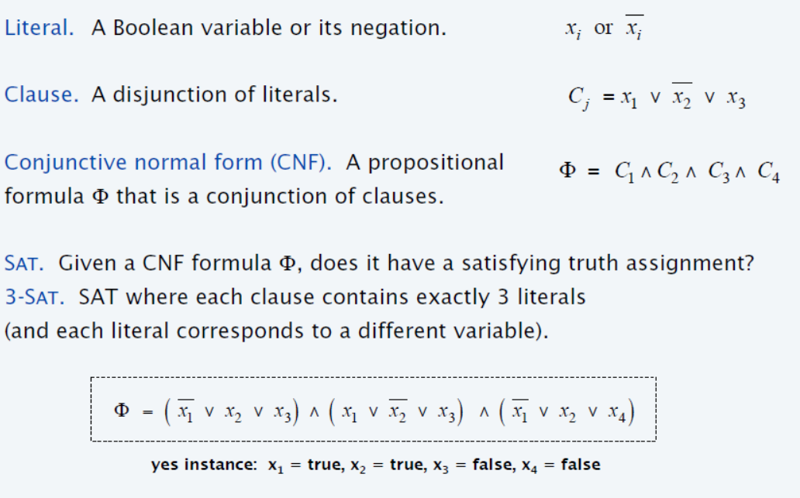
Satisfiability

Slide 12
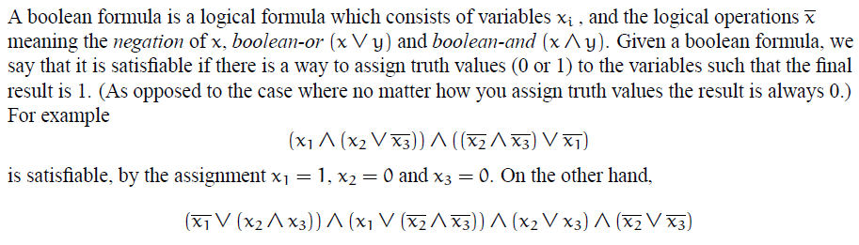
Cook’s Theorem
SAT problem is stated as follows:

Slide 13
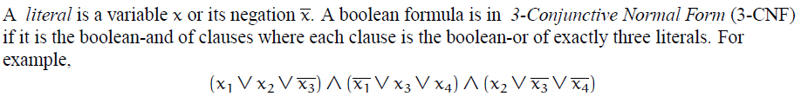
Cook’s Theorem
Even a more reduced version of SAT problem is also NP-complete. 3CNF is reduced form of SAT problem and it is also NP-complete
The above expression is 3CNF SAT form where is one clause that has three literals. So the above expression has 3 clauses with 3 literals in each. As each clause is separated by “And operation” so answer to this complete expression will evaluate to true if each clause will evaluate to true.

Slide 14
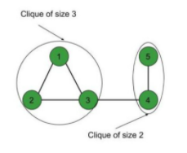
Reduction Example 1: Reducing 3CNF SAT to Clique decision problem
Clique decision problem
In clique decision problem, we must find whether there exists clique of size “k”. Clique of size “k” means if there exists “k” number of vertices that are making a clique (complete sub-graph)
Like if k=3 then we need to find if there exists 3 number of vertices that are making a clique(complete sub-graph). So for below graph it is YES as it has vertices 1,2 and 3 that are making clique.
Please note that clique problem(clique decision problem) is different from clique cover problem. We saw in previous lecture in clique cover problem that “k” is total number of cliques. But in clique problem(clique decision problem), k is total number of vertices that are making a clique.

Slide 15

Reduction Example 1: Reducing 3CNF SAT to Clique decision problem
For example, you want to reduce this expression of 3CNF to clique decision problem :
Where means (negation of x1).
So steps to follow while reducing 3CNF to clique decision problem:
For each clause, create a vertex for each literal
For the edges, connect vertices if they come from different clauses (do not connect vertices in same clause)
No vertex (literal) should be connected to its negation in other clause.

Slide 16
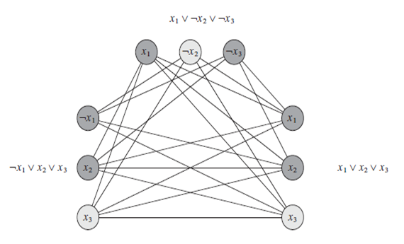
Reduction Example 1: Reducing 3CNF SAT to Clique decision problem
The final graph will look like this :
If k=3 then in above graph we have clique of size 3.

Slide 17
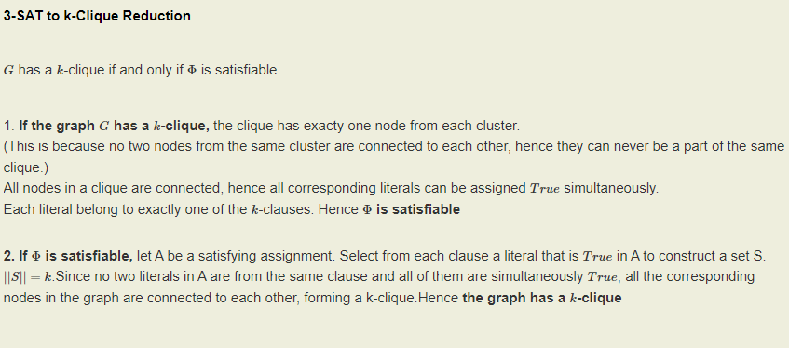
Reduction Example 2: Reducing 3CNF SAT to Clique decision problem

Slide 18
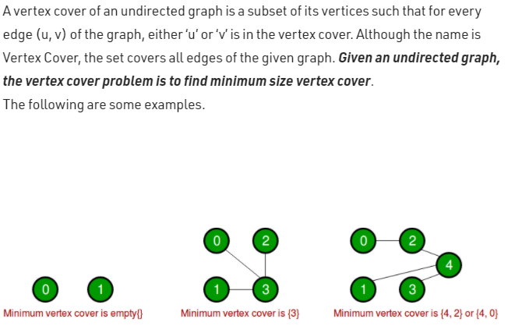
Reduction Example 2: Reducing clique decision problem to vertex cover
Vertex Cover Problem :

Slide 19
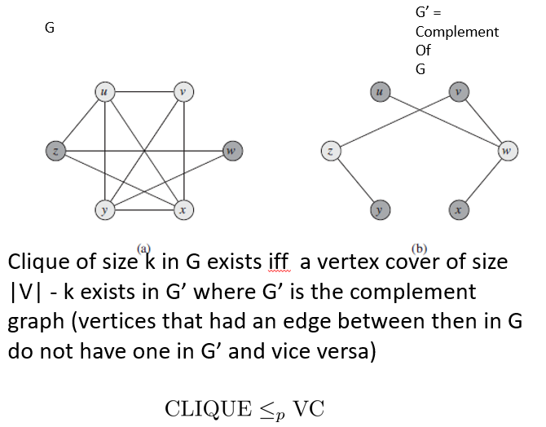
Reduction Example 2: Reducing clique decision problem to vertex cover

Slide 20
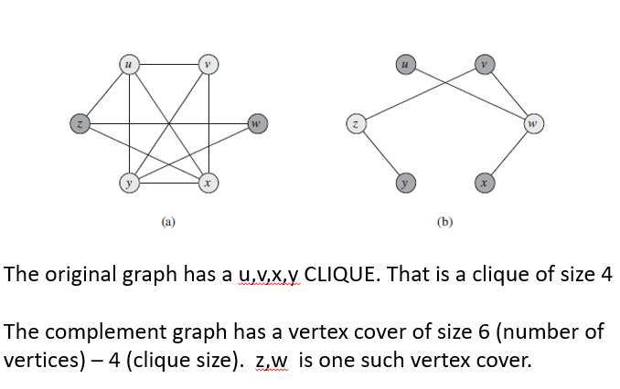
Reduction Example 2: Reducing clique decision problem to vertex cover

Slide 21
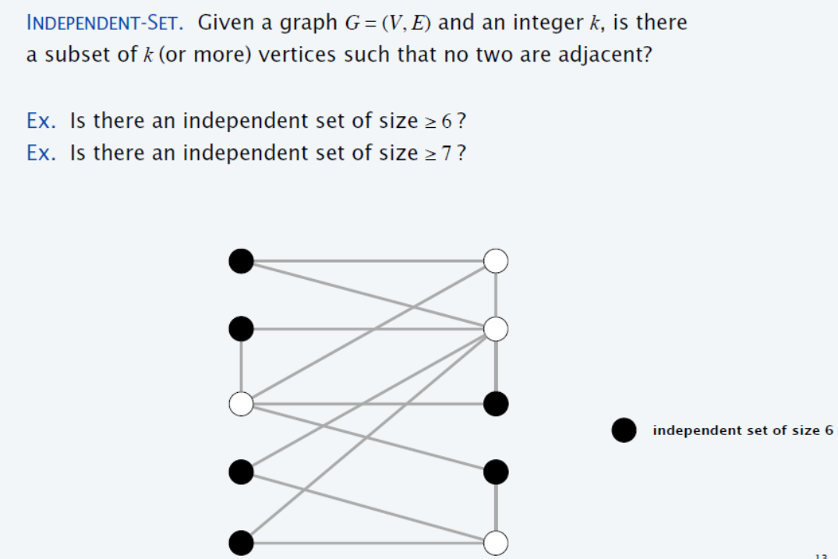
Independent Set (Example 3)
{1} is independent Set
{2, 3} is independent Set
{1, 3} is independent Set
{1, 3, 6} is independent Set
1
2
{2, 5, 6, 7} is independent Set
3
4
{1, 3, 6, 7} is independent Set
{1, 3, 6, 7, 8 , 9} is independent Set
5
6
7
8
9
10
Notes:
Independent-set set to Vertex Cover = V-Answer of Independent-set(S)

Slide 22
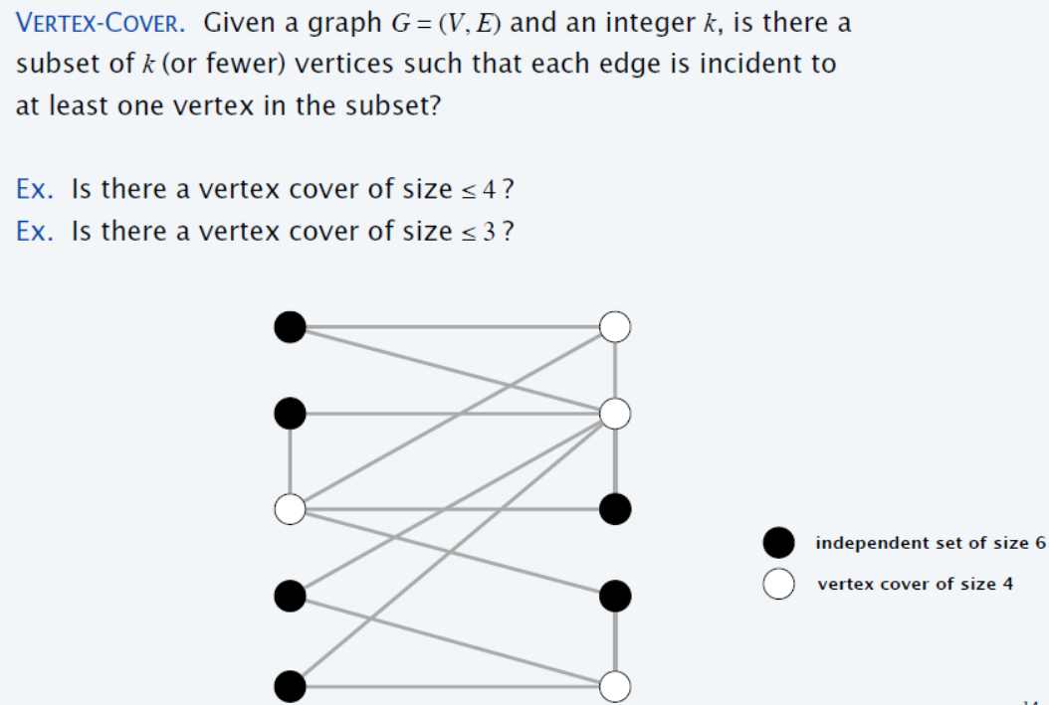
Vertex Cover (Example 3)
1
2
3
4
5
6
7
8
9
10

Slide 23
Vertex Cover is NP-Complete
Recipe to Prove a Problem Is NP-Complete
Prove that a Vertex Cover is NP-Complete
Step 1. Vertex Cover ∈ NP
Step 2. Choose an NP-Complete problem A (Independent Set).
Prove that A (Independent set) reduces to B (Vertex Cover)
INDEPENDENT-SET ≤_{p} VERTEX-COVER.
Notes:
We already have solution of Independent Set (Problem A), and we want to use the same solution of Problem A for Problem B (Vertex Cover), and this mapping of solution A to solution B (solution B needs to find out), must be in polynomial time)

Slide 24
Step 1: Vertex Cover ∈ NP
Given Graph G = (V, E) contains Vertex cover of Size 3?
S is vertex cover if every edge in E has at least one endpoint in S.
(Example V.C = {2,3,7})
1
2
3
4
5
6
7
Notes:
We can verify in P-time

Slide 25
Vertex cover and independent set reduce to one another
Lemma: INDEPENDENT-SET ≤_{p} VERTEX-COVER.
Proof: We show S is an independent set of size k,
iff V − S is a vertex cover of size n – k.
Let S be any independent set of size k.
Consider an arbitrary edge (u, v) ∈ E.
S independent ⇒ either u ∉ S, or v ∉ S, or both ∉ S.
Vertex Cover (V-S)⇒ either u ∈ V − S, or v ∈ V − S, or both ∈ V − S.
Thus, V − S covers (u, v). ▪
2
S = {4,5}
4
5
7

Slide 26
Independent Set (Example 4)
S is independent if there are no edges between vertices in S.
(Example I.S = {1,4,5,6})
V.C = V – S
(V.C ={2,3,7})
1
2
1
2
VC = V - S
3
4
5
3
4
5
6
7
6
7
Notes:
Indepenset set to Vertex Cover = V-Answer of indepense set(V)
Compliment graph of indepenset set in cliqie

Slide 27
Clique (Example 4)
Clique
Graph G = (V, E), a subset S of the vertices is a clique if there is an edge between every pair of vertices in S. (Example Clique = {1,4,5,6})
2
1
Clique of size 4
3
4
5
6
7

Slide 28
Clique is NP-Complete
Recipe to Prove a Problem Is NP-Complete
Prove that a Clique is NP-Complete
Step 1. Clique ∈ NP.
Step 2. Choose known NP-Complete problem A (IS).
Prove that A (IS) reduces to B (Clique)
IS ≤_{p} Clique.

Slide 29
Step 1: Clique ∈ NP.
Graph G = (V, E), a subset S of the vertices is a clique if there is an edge between every pair of vertices in S. (Example Clique = {1,4,5,6})
Given graph contains Clique of size = 4 ?
2
1
3
4
5
6
7
Notes:
Every vertex of S contained each other. (Mesh Connected)

Slide 30
Step 2: IS ≤_{p} Clique
Lemma: S is Independent in G iff S is a Clique in the complement of G
To reduce IS to Clique, we compute the complement of the graph. The complement has a clique of size K iff the original graph has an independent set of size K.
Construction of Complement of the graph can easily be done in polynomial time.

Slide 31
IS ≤_{p} Clique (Example 4)
2
1
2
Complement
1
3
4
5
3
4
5
6
7
6
7
Independent-Set of Size 4
Clique of Size 4

Slide 32
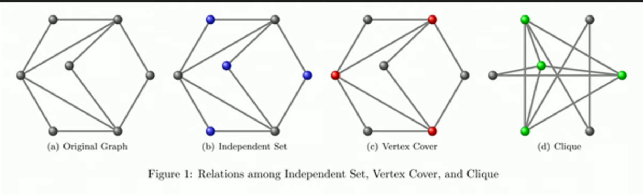
Reduction: Independent Set, Vertex Cover, and Clique (Example 4)

Slide 33
INDEPENDENT-SET is NP-Complete
Recipe to Prove a Problem Is NP-Complete
To prove that a problem B (INDEPENDENT-SET) is NP-Complete:
Step 1. INDEPENDENT-SET ∈ NP
Step 2. Choose an NP-Complete problem A (3-SAT).
Prove that A (3-SAT) reduces to B (INDEPENDENT-SET)
3-SAT ≤_{p} INDEPENDENT-SET

Slide 34
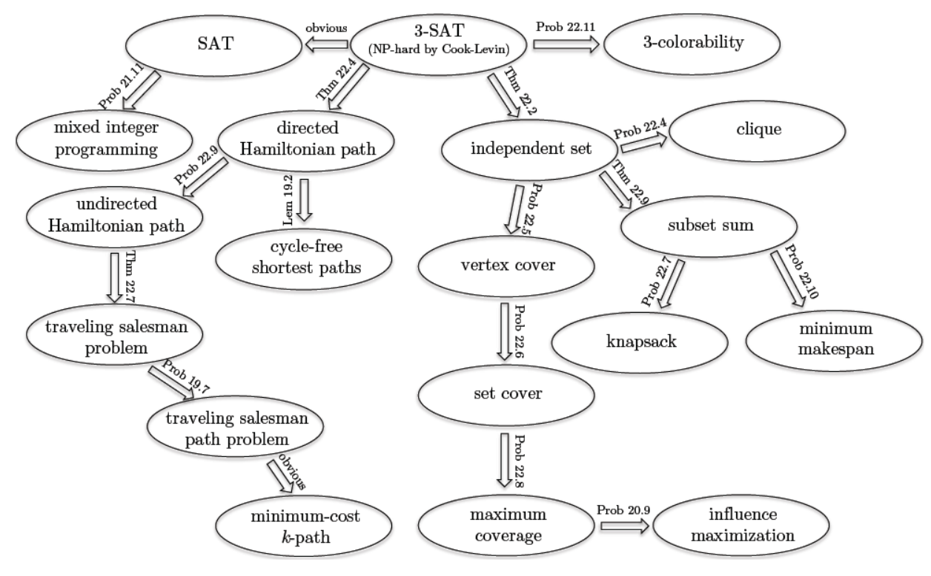
Cook-Levin theorem shows that 3-SAT is a “universal” problem

